Slide 1
Embedded Learning Multi-Domain Convolutional Neural Networks for Visual Tracking
CSED499I
Requirements Analysis
20080650 CSE
Jeongbin Choe
Advisor: Prof. Bohyung Han (CV Lab)

Slide 2
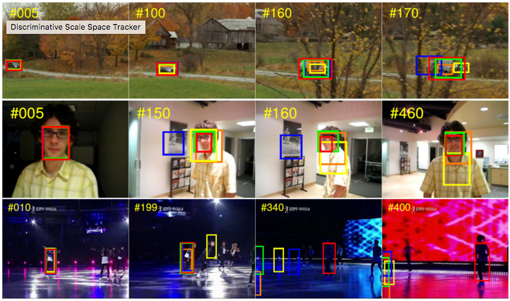
Introduction
Convolutional Neural Network (CNN)
Deep (Multi-layer) neural network
Applied to various computer vision tasks
Visual Tracking
Locating, identifying and determining the configuration of moving objects

Slide 3
Introduction
Multi-Domain Network (MDNet)
Consists of shared CNN layers and multiple branches of domain-specific layers
MATLAB based framework
The winner of The VOT2015 Challenge
Performed 1 fps with 8 cores Intel Xeon CPU + NVIDIA Tesla
Project Goal
Port MDNet to iPhone 6+ and optimize its performances
Implement MDNet based real-time learning and object tracking (or classifying) application

Slide 4
User requirements
Embedded MDNet
Performs visual tracking on iPhone 6+ with targets used in VOT2014 and VOT2015 challenges
Keeps at least 1 fps
YouTube
Real-time Application
Requires user to teach the neural networks with objects detected by scanning around with a camera
After training, performs real-time visual tracking through the camera
Or, it may be more fancy for user to perform objects classifying (labeling) rather than visual tracking

Slide 5
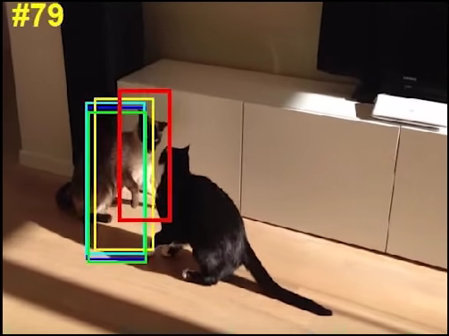
System requirements - Embedded MDNet
{
“pooling_param”: {
“stride”: 1,
“kernel_size”: 8,
“pool”: 1
},
“name”: {
“top”: [
0.97 fps
JSON formatted models
train
CNN-layers
(DeepLearningKit or torch-ios)
track
optimize
convert
Fernando
Sequence
MDNet pretraining models
Reduce the size of input or the number of layers
Remove online tracking process

Slide 6
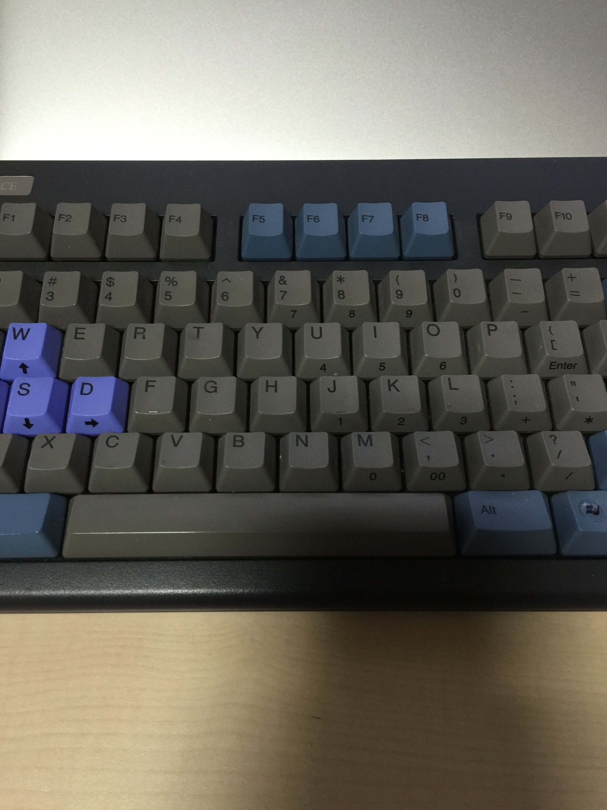
System requirements - Application
training…
Trained
Embedded MDNet
realtime track
train
keyboard
Image Raw Data
Recognize objects
in camera
label

Slide 7
Interface requirements
0.97 fps
Embedded MDNet
Fernando
Sequence
Focus your camera at the object that you want to track.
training…
Realtime Application
Start training

Slide 8
Project Summary
Port MDNet (MATLAB based framework) to iPhone 6+
Keep at least 1 fps to optimize embedded MDNet’s performances
To reduce the size of input or the number of layers
To remove online tracking process
Implement MDNet based real-time learning and object tracking (or classifying) application

Slide 9
References
Hyeonseob Nam and Bohyung Han, Learning Multi-Domain Convolutional Neural Networks for Visual Tracking, arXiv, 2015.
Y. Wu, J. Lim, and M. Yang. Object tracking benchmark. TPAMI, 2015.
http://acsweb.ucsd.edu/~yuw176/report/ECE273.pdf
http://www.votchallenge.net/vot2015
http://deeplearningkit.org
https://github.com/clementfarabet/torch-ios

